Slide 1
Basic Java
Unit 4 – Abstract Classes and Interfaces

Slide 2
Topics
Interfaces
Interface as a contract
Programming to the interface vs. programming to the implementation
Interface and Multiple Inheritance
Inheritance among interfaces
Abstract classes & Abstract methods
Abstract methods as a contract
Polymorphism revisited

Slide 3
Abstract Classes
An abstract class is a class that exists only as a notion, and has no real world mapping.
An abstract class cannot be instantiated.
An abstract type always exists as one or more sub types.
An abstract class serves as a placeholder for common structure and behavior, which all it’s sub classes can reuse.

Slide 4
Abstract classes in Java
An abstract class can be defined by use of the keyword ‘abstract’ in the class definition
abstract class Vehicle class AbstractDemo
{ {
Engine e; public static void main(String[] args)
FuelTank tank; {
void pullFuelFromTank() Vehicle v = new Vehicle();
{..........} Error – Abstract class cannot be instantiated
void regulateEngineTemp() }
{.........} }
void start() { }
void stop() { }
}
How do we then use the functionality offered by this abstract class ?

Slide 5








Abstract classes in Java
In real world, Vehicle exists in more than one forms as Bus, Car, Truck and so on
Vehicle
Classes Car, Bus, Truck all extend the abstract class Vehicle and reuse the structure and behavior defined.
Vehicle, which has no real world mapping is not represented, not allowed to be instantiated in our application
e: Engine
tank: FuelTank
temperature: int
pullFuelFromTank()
regulateEngineTemp()
Bus
Car
Truck
busStops: ArrayList
ac: AirConditioner
maxGoodsWt: int
switchOnAC()
loadGoods()
getBusStopList()

Slide 6
Abstract Classes
public abstract class Vehicle
{
Engine e;
FuelTank tank;
void pullFuelFromTank(){..........}
void regulateEngineTemperature(){.........}
void start(){...........}
void stop(){...............}
}
public class Car extends Vehicle
{
switchOnAC(){…….}
}
public class Truck extends Vehicle
{
loadGoods(){…….}
unloadGoods(){…….}
}

Slide 7
Why Abstract Classes?
To not allow instantiation of a class, since it has no real world representation.
To capture all common structure and behavior in the base class, so that it can be reused by all sub types.
Refer to AbstractClassExercise.doc

Slide 8
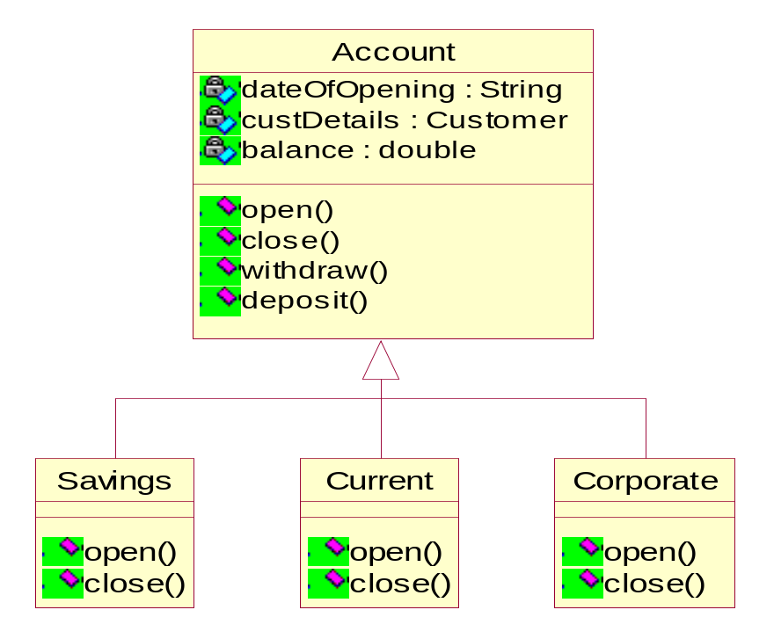
Abstract Methods
An abstract method is a method with no implementation / body.
Must be members of either abstract classes or interfaces.
What is the implementation of methods open() and close() in Account ?

Slide 9
Abstract Methods
A class with one or more abstract methods has to be marked as abstract.
abstract class Account
{
private String dateOfOpening;
private Customer custDetails;
private double balance;
public void withdraw(double amt)
{
// Implementation
}
public void deposit(double amt)
{
// Implementation
}
public abstract void open();
public abstract void close();
}
class Savings extends Account
{
public void open()
{ // Implementation
}
public void open()
{ // Implementation
}
}
class Current extends Account
{
public void open()
{ // Implementation
}
public void open()
{ // Implementation
}
}
Refer to : AbstractMethod.doc

Slide 10
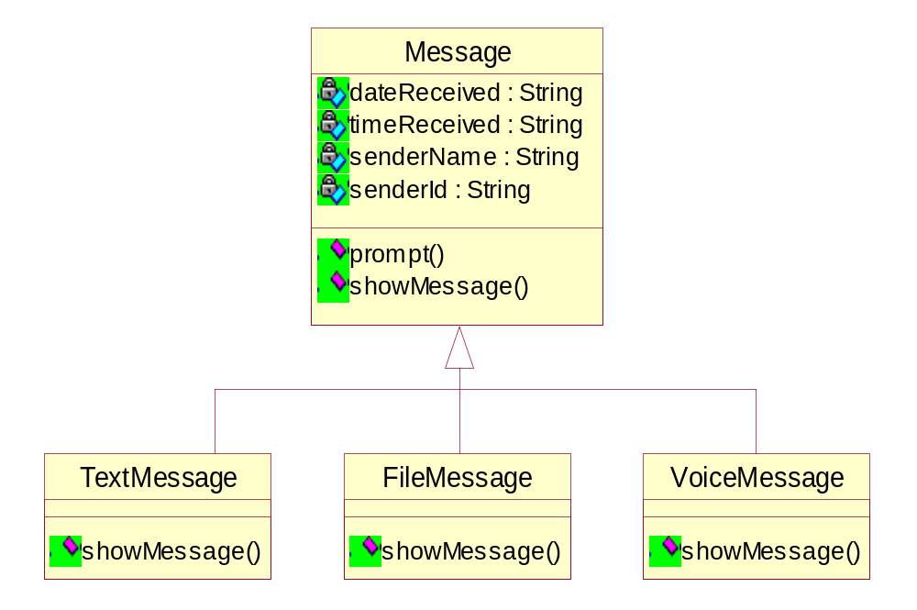
Abstract Methods as a contract
Abstract methods serve as a contract between design and implementation
During design phase, it is convenient to identify and design abstract methods and defer the implementation details to the development phase.

Slide 11
Abstract Methods as a contract
abstract class Message
{
private String dateReceived;
private String timeReceived;
private SenderDetails sender;
public String getDateReceived()
{
return dateReceived
}
public void setDateReceived(String dt)
{
dateReceived = dt;
}
public void prompt()
{
// logic of the method …
}
public abstract void showMessage();
}

Slide 12
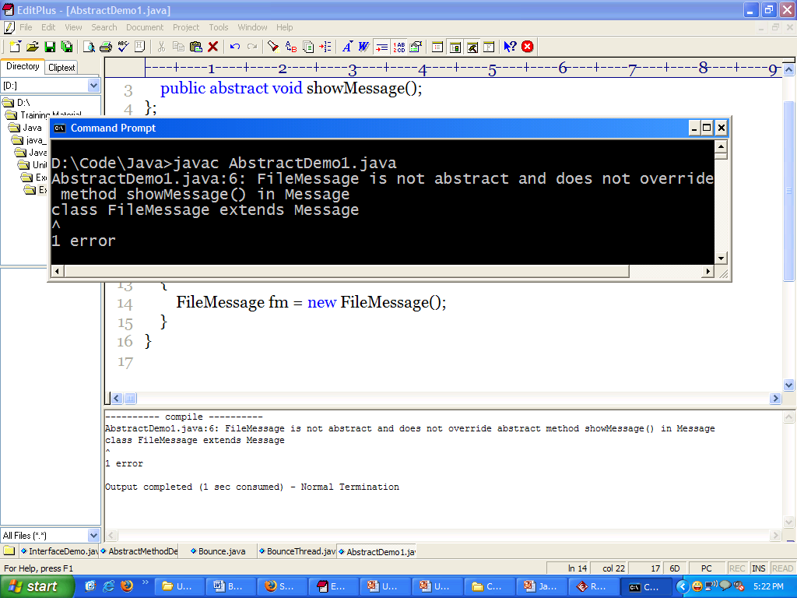
Abstract Methods as a contract
class TextMessage extends Message
{
public void showMessage()
{
// Implementation
}
}
class FileMessage extends Message
{
public void getFileFormat()
{
// Implementation
}
public void launchApplication()
{
// Implementation
}
}
FileMessage is required to override the method showMessage()

Slide 13
Polymorphism revisited…
All sub classes of Message, namely,TextMessage, FileMessage and VoiceMessage are required to override the method - public void showMessage().
A generic method can be designed which takes the abstract type reference as argument, to which any derived type object can be passed.
Abstract type reference
class MessageReceiver
{
public void onMessage(Message msg )
{
msg.prompt();
msg.showMessage();
}
}
class MessageDemo
{
private MessageReceiver mr = new MessageReceiver();
public static void main(String[] s)
{
TextMessage t = new TextMessage();
FileMessage f = new FileMessage();
mr.onMessage(t);
mr.onMessage(f);
}
}
Derived type object

Slide 14
Exercise
Write an abstract class Shape with method double area(). Different sub classes of Shape namely Circle, Rectangle, Triangle override the area() method.
Write a class AreaFinder that has a method showArea, that takes any Shape object and displays its area.
Write a Demo class and test the code

Slide 15
Summarizing…
An abstract class cannot be instantiated.
An abstract class can contain both concrete methods as well as abstract methods.
An abstract method has no body.
Abstract methods in an abstract class need to be overridden by it’s sub class

Slide 16
Interfaces
Interface is a java construct with method declarations only.
Interface is a group of related methods with no implementation.

Slide 17
Defining an Interface
The keyword ‘interface’ is used to define an interface.
All methods declared within an interface are implicitly public and abstract
public interface CharSequence
{
char charAt(int index);
int length();
}
Abstract Methods

Slide 18
Implementing an interface
A class then is said to ‘implement’ an interface, making use of the keyword ‘implements’.
The class that implements the interface has to provide the logic for all methods defined in the interface.
public class String implements CharSequence
{
public char charAt(int index)
{
// The implementation of this method
}
public int length()
{
// The implementation of this method
}
}

Slide 19
Interface as a ‘type’
When we define a new interface, we are defining a new reference data type
  Very similar to defining a class, that is a reference data type
To a reference variable whose type is an interface, an object of the class that implements the interface can be assigned.
  For Example
    CharSequence cs = new String();
See Listing : InterfaceDemo.java

Slide 20
Interface as a contract
Imagine an interface with some method signatures, and a class that will implement the interface.
An interface is a contract. It is a binding between the interface and the class that implements the interface.
Interface : I have 5 method signatures.
Class : I want to implement them.
Interface : Okay. But then you have to implement all of them. You are not allowed to say that you implement me without implementing every single one of my methods.
Class : It's a deal.

Slide 21
Interface as a contract
Interface serves as a contract between design and implementation.
At design time, it is convenient to discover what functionality needs to be achieved and specify as an interface.
Based on varied implementation, different classes will implement the interface in different ways.
Nevertheless, all classes need to conform to the contract.

Slide 22
Why implement an Interface?
Implementing an interface allows a class to become more formal about the behavior it promises to provide.
Interfaces form a contract between the class and the outside world, and this contract is enforced at build time by the compiler.
If a class claims to implement an interface, all methods defined by that interface must appear in its source code before the class will successfully compile.

Slide 23
Interface and constants
An interface can also have data members defined in it, that serve as global constants.
All data members defined in an interface are implicitly public static final.
interface OlympicMedal
{
String GOLD = "Gold";
String SILVER = "Silver";
String BRONZE = "Bronze";
}
Constants being defined

Slide 24
Interfaces and abstraction
There are a number of situations in software engineering when it is important for disparate groups to work in parallel.
Each group should be able to write their code without any knowledge of how the other group's code is written.
Interfaces help in bringing about such an abstraction for the class users.
Both the class creators and the class users heavily depend on the contract defined.
  While the class creators actually ‘implement’ the contract, the class users simply ‘use’ the interface

Slide 25


Interfaces and abstraction
Class Creator
Class User
public interface ItemList
{
void addItem (Object obj);
Object[] getItems();
}
defines
uses
Class Users are abstracted from implementation details
public class SequentialItemList implements ItemList
{
public void addItem (Object obj) { …. }
public Object[] getItems() { …. }
}
public class RandomItemList implements ItemList
{
public void addItem (Object obj) { …. }
public Object [] getItems() { …. }
}
public class Client {
ItemList i1 = new SequentialItemList();
i1.addItem(new Sale());
Sale[] sales = (Sale[]) i1.getItems();
ItemList i2 = new RandomItemList();
i2.addItem(new Book());
Book[] books = (Book[]) i2.getItems();
}

Slide 26
Programming to Interface
It is a good programming practice to program to an interface and not to the implementation
It is a good design to have methods take the generic interface type as arguments.
  As discussed earlier, an interface reference can be used anywhere a type can be used.
The advantage being, a change in the implementation would not have an impact on the client code.

Slide 27
Programming to interface
What if Taxation rules change and we write a new class TaxCalc2007 ?
public interface StdTaxCalc
{
double getIncomeTax(salaryDetails details);
double getFBT(InvestmentDetails details);
}
public class SalaryCalculator
{
void computeSalary()
{ …..
TaxCalc2006 tc = new TaxCalc2006();
tc.getIncomeTax(sd);
tc.getFBT(id);
}
}
public class TaxCalc2006 implements StdTaxCalc
{
double getIncomeTax(salaryDetails details)
{ …. }
double getFBT(InvestmentDetails details)
{ …. }
}

Slide 28
Programming to the Interface
Always program to the interface type
public class SalaryCalculator
{
void computeSalary()
{
SalaryDetails sd;
InvestmentDetails id;
…..
StdTaxCalc tc = TaxCalcCreator.getObject();
tc.getIncomeTax(sd);
tc.getFBT(id);
}
}

Slide 29
Interface and Multiple Inheritance
A class can implement multiple interfaces
  Although the class can inherit only one other class.
The class that implements multiple interfaces has to conform to multiple contracts
  The class is required to provide implementation for all the methods defined in all the interfaces that it implements.
Interface implementation is essentially behavioral reuse, while inheritance is structural reuse as well.
  Hence, Java allows a class to implement multiple interfaces
This feature is many times seen as Java’s way of substituting multiple inheritance

Slide 30
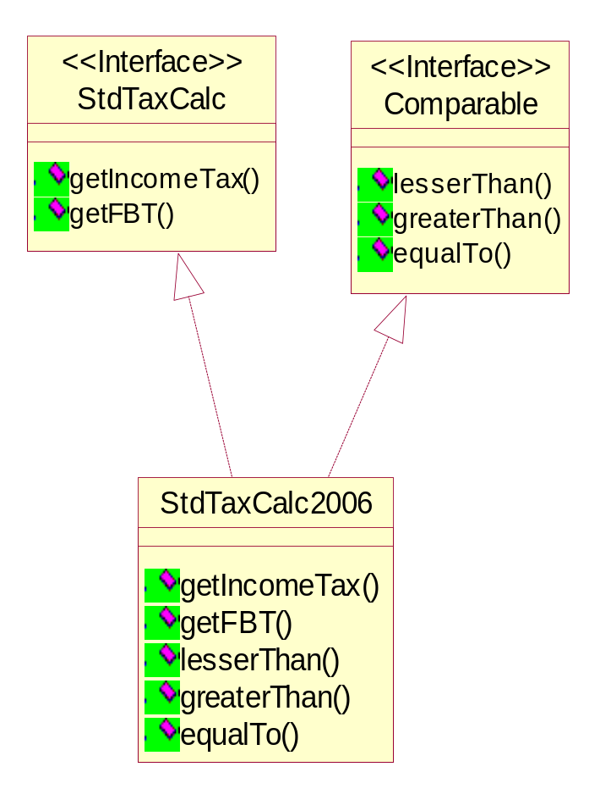
Interface and Multiple Inheritance
TaxCalc2006 is one particular implementation of the StdTaxCalc interface.
Let us suppose that it also needs to be Comparable
Since we already have an interface Comparable defined, TaxCalc2006 implements two interfaces and conforms to both contracts
implements
implements

Slide 31
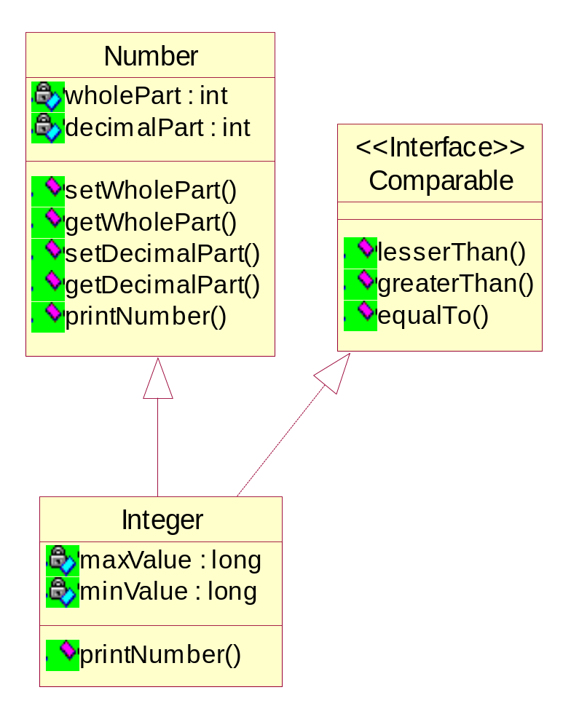
Interface and Multiple Inheritance
Class Integer needs to conform to both contracts, namely, being a Number and being Comparable
Class Integer therefore extends the abstract class Number and implements the Comparable interface
implements
extends

Slide 32
Inheritance among Interfaces
Scenario 1
  We have to define an interface that exposes some functionality. We realize that a few of those methods are already defined in another interface.
Scenario 2
  We have defined an interface with five method declarations. A few classes implement this interface and provide implementation for all the methods defined.
  Let us suppose that we have received new requirements, because of which we are required to include two additional methods to the interface.
Should we redundantly define those methods in the new interface as well ?
If we change the existing interface to include two methods, what happens to the existing classes that implement the interface?

Slide 33
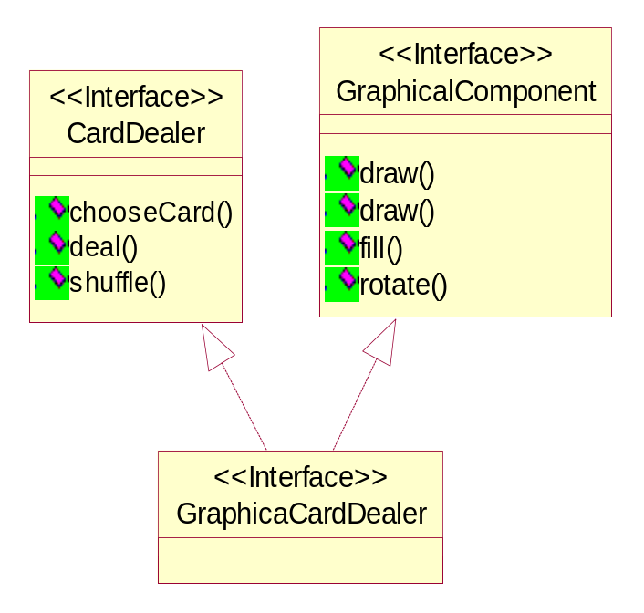
Inheritance among interfaces
As a solution to both problems, we have inheritance among interfaces.
An interface can ‘extend’ one or more interfaces.
extends
extends

Slide 34
Summarizing…
An interface defines a protocol of communication (contract) between two objects.
An interface declaration contains method signatures, but no implementations, and might also contain constant definitions.
A class that implements an interface must implement all the methods declared in the interface.
Multiple interfaces can be implemented by a class.
Interfaces help in bringing about abstractions
Always remember to program to the interface and not to the implementation

Slide 35
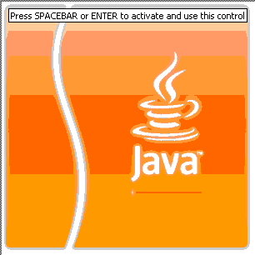

Question time
Please try to limit the questions to the topics discussed during the session. Thank you.

